Slide 1
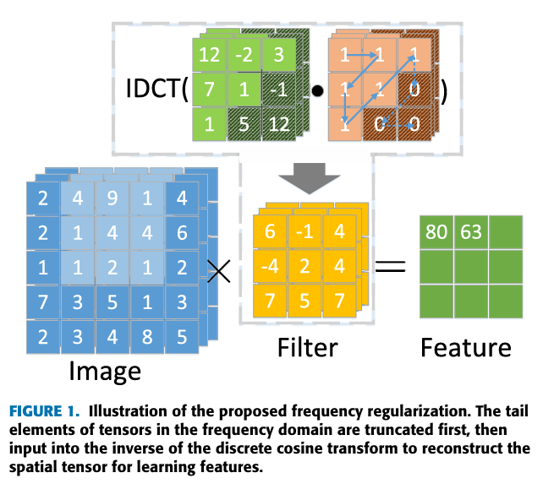
Frequency Regularization: Reducing Information Redundancy in Convolutional Neural Networks
Inverse Discrete Cosine Transform (IDCT)
Reconstruct parameters in the spatial domain.
Enable conventional convolution or fully connected operations in the spatial domain.
Ensure that model training and inference remain unaffected.
The entire frequency domain representation and pruning process is fully differentiable.
Notes:
The pruned frequency-domain parameters are passed through the Inverse Discrete Cosine Transform (IDCT) to reconstruct them back into the spatial domain. This allows us to continue performing standard convolution or fully connected operations in the spatial domain. It ensures that the model's training and inference processes remain unaffected. The entire frequency-domain representation and pruning process are fully differentiable. By introducing a differentiable mask matrix, we enable backpropagation to update the frequency-domain parameters during training. This ensures that the model retains its ability to learn parameters effectively in the frequency domain.

Slide 2
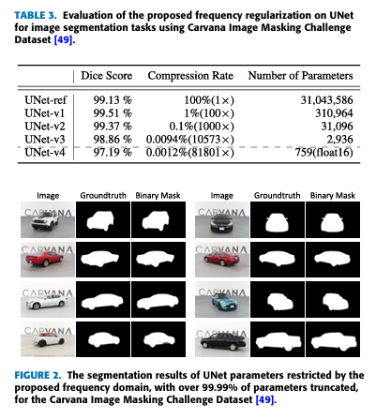
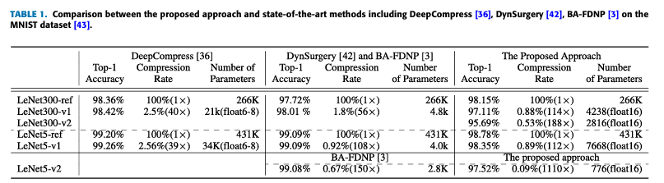
Frequency Regularization: Reducing Information Redundancy in Convolutional Neural Networks
Notes:
One big advantage of frequency regularization is its very high compression rate. In LeNet5, we compressed 0.4 million parameters down to just 776 parameters, achieving over 1000 compression. In UNet, we reduced 34 million parameters to only 759 parameters, reaching an 80,000x compression rate. Even though so many parameters are removed, the model’s performance stayed almost the same. For example, in the Carvana Image Masking dataset, the UNet model still has a Dice score of 97.19%. Of course, such extreme compression is due to multiple reasons. Besides the effectiveness of our method, the task itself is not very complex, meaning the original network had a lot of redundant information.

Slide 3
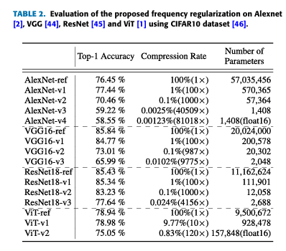
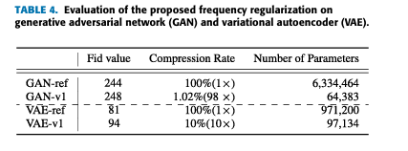
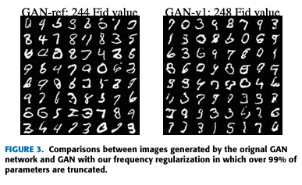
Frequency Regularization: Reducing Information Redundancy in Convolutional Neural Networks
Notes:
Frequency regularization is a highly flexible method that can be used in almost all types of neural network architectures. We tested its effectiveness on many popular network architectures, including convolutional networks like AlexNet, VGG, and ResNet, self-attention networks like ViT, and generative models like GANs and VAEs. In all these architectures, frequency regularization works smoothly.

Slide 4
Accelerating Inference of Networks in the Frequency Domain
Challenges:
Computational overhead caused by frequent domain transitions.
Challenges in handling nonlinear layers.
Solution:
How can we ensure that the input and output of each layer remain in the frequency domain, thereby avoiding additional DCT and IDCT operations?
Frequency Domain Inference Chain!
Notes:
Although frequency regularization can effectively make parameters sparser during training, each layer still needs to perform Discrete Cosine Transform (DCT) and Inverse DCT (IDCT). This greatly limits the speed-up during inference. Additionally, nonlinear layers like ReLU and BatchNorm are important parts of deep learning networks, and they are usually designed for the spatial domain. To keep data consistent between training and inference, these operations often require converting data back to the spatial domain, which adds extra computation. To solve these challenges, our goal is to build a fully frequency-based inference pipeline, so that DCT and IDCT are only performed once—at the input and output of the network. We also propose a method to directly handle nonlinear operations in the frequency domain, reducing the need for switching between domains and minimizing computation costs.

Slide 5
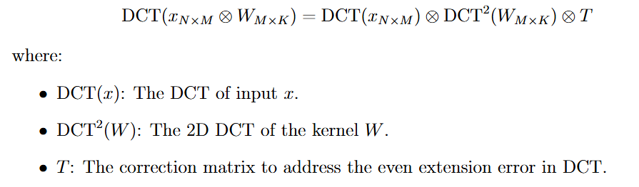
Accelerating Inference of Networks in the Frequency Domain
Convolution Theorem: Convolution in the spatial domain is equivalent to element-wise multiplication in the frequency domain.
Notes:
The idea behind frequency inference Chain comes from the convolution theorem, which states that convolution in the spatial domain is equal to element-wise multiplication in the frequency domain. Convolution in the frequency domain can be seen as first applying DCT to the input x. Then, multiply it by a 2D DCT-transformed kernel w. Finally, it is multiplied by a correction matrix.

Slide 6
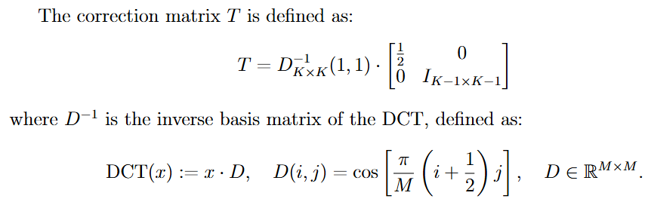
Accelerating Inference of Networks in the Frequency Domain
Convolution Theorem: Convolution in the spatial domain is equivalent to element-wise multiplication in the frequency domain.
Notes:
Now, why is T necessary? Although the convolution theorem states that convolution in the spatial domain can be converted into element-wise multiplication in the frequency domain, the problem is that the output of the DCT transform is not strictly in the frequency domain. Instead, it exists in an “extended space” caused by the way DCT-II performs even extension. This means that the structure of the transformed data is slightly different from real frequency-domain data. The T matrix is introduced to correct the error caused by this even extension. One important thing to note is that some studies assume DCT is orthogonal, but in reality, DCT-II is not fully orthogonal unless it applies orthogonal normalization. This is why we need the T matrix to correct it.
The T matrix is defined as the (1,1) entry of the inverse DCT transformation matrix, multiplied by another matrix. This second matrix has 1/2 in the top-left corner, while the rest of it is an identity matrix.

Slide 7
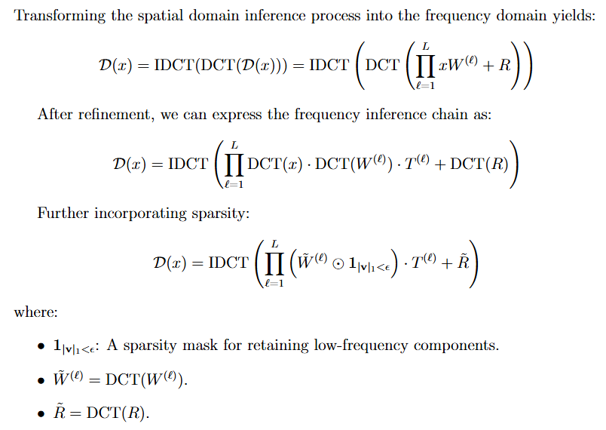
Accelerating Inference of Networks in the Frequency Domain
Notes:
Finally, we get the final formula. First, we move the network from the spatial domain to the frequency domain. Then, we apply the transformations for each layer and include the T matrix in every layer. Just like before, we gradually prune the high-frequency components. This gives us the final formula for the frequency inference chain.

Slide 8


Accelerating Inference of Networks in the Frequency Domain
Handling Nonlinear Layers in the Frequency Domain
Compromise Solution
Possible Improvement:
Approximating nonlinear functions using Fourier transform.
Notes:
Nonlinear layers like ReLU and BatchNorm are important parts of deep learning models. They help the network learn complex patterns. But these layers are designed for the spatial domain. When we move the entire network to the frequency domain, handling these layers becomes a challenge. We choose a compromise solution: applying nonlinear operations directly in the frequency domain. For ReLU, after converting the input data with DCT, we apply ReLU directly on the frequency data. This method assumes that the frequency data is similar to the spatial data. For BatchNorm, we do the same thing. This approach has some limitations, but experiments show that it works well in most cases. Since ReLU and BatchNorm were originally designed for the spatial domain, applying them directly in the frequency domain can lead to some information loss. When the inference speed is 10 times faster, the model's accuracy drops by about 3%. This happens because the frequency data does not fully match the original design of these layers. However, when the inference speed is 150 times faster, the benefits of using the frequency domain are much greater than the small mismatch in nonlinear operations. The future improvements could involve designing new nonlinear layers based on Fourier transform, since Fourier transforms can approximate any function.

